Slide 1
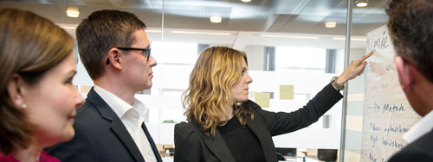
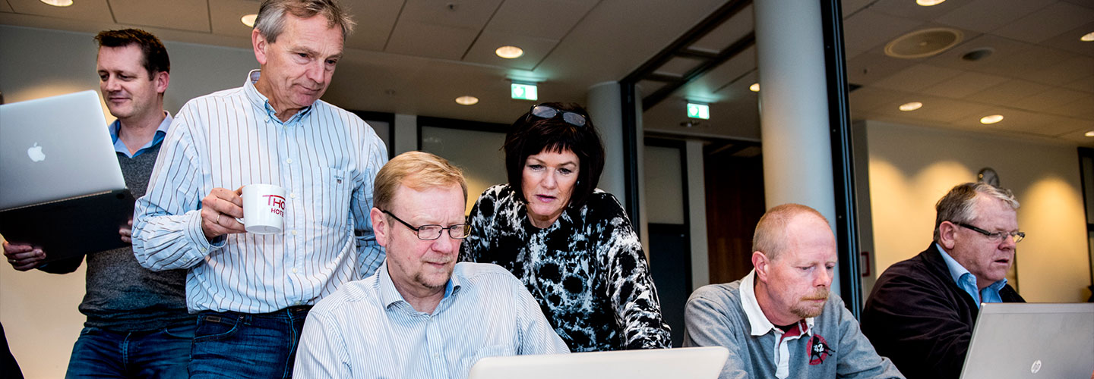
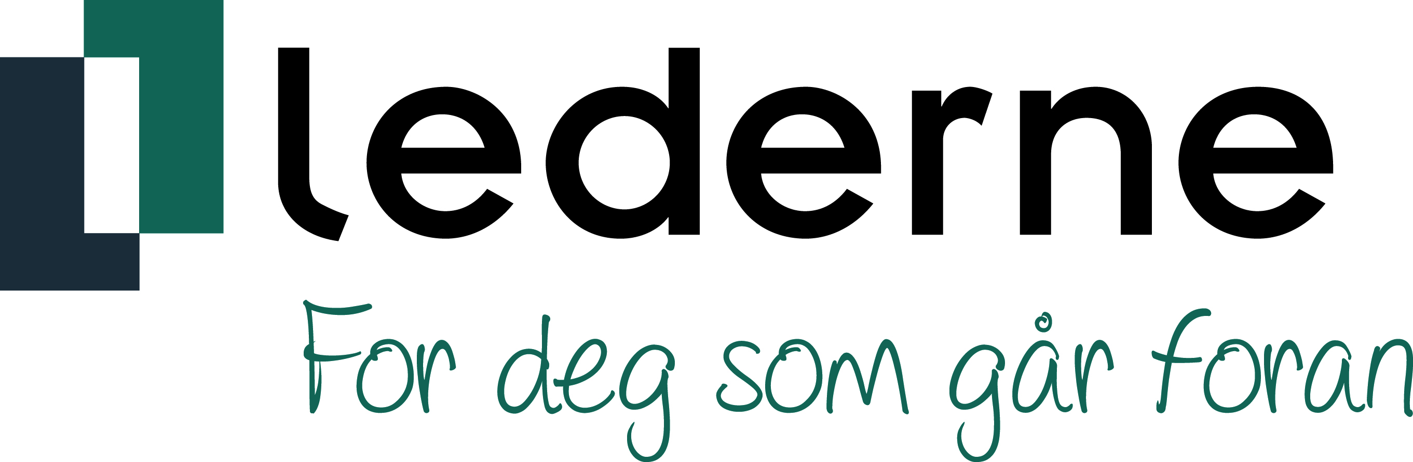
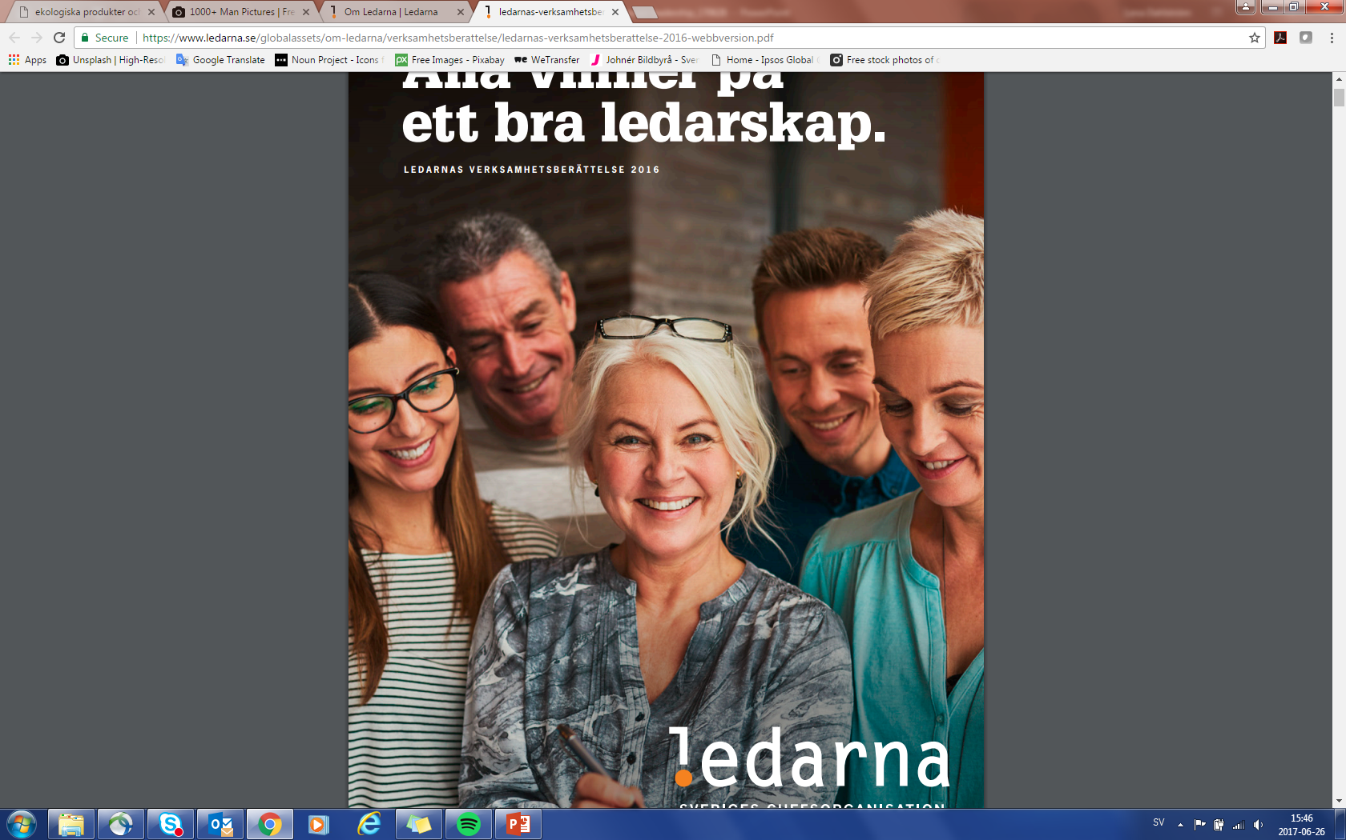

Scandinavian leadership A survey of leaders/managers in Denmark, Norway and Sweden
For LEDARNA: Ebba Öhlund
For IPSOS: Sofia Zere
26/06/16

Slide 2
Scandinavian leadership
Ledarna, in partnership with its sister organisations in Denmark and Norway, wanted to conduct a joint survey of managers/leaders in Scandinavia in preparation for a conference taking place in Stockholm in June 2017.
The aim of the survey was to identify what values are typical for 'Scandinavian leadership' and find out how these manifest themselves in practice. As well as demonstrating similarities, the survey also aimed to highlight differences between the Scandinavian countries in terms of leadership and leadership practice.
The survey was taken online by leaders/managers with membership in their country's union in either Denmark, Norway or Sweden, with a total of 1559 interviews also conducted between 22 May and 5 June 2017.
The results show us that there is a Scandinavian type of leadership with common values and characteristics. Scandinavian leadership is characterised by three central features. The first characteristic is a high level of employee involvement in the decision-making process. The second is the short distance between managers/leaders and employees. The third and last is the 'freedom with responsibility', which means that the employee has ample space in which to take initiative and work independently.
The values and styles of leadership that distinguish the counties should be regarded more as subtle distinctions rather than major differences. In Denmark, for example, leaders tend to delegate more, requiring employees to be very independent, whereas in Norway leaders place more of a focus on wellbeing and job satisfaction, and in Sweden more on coaching.
Ultimately we have managed to identify three different types of successful leadership that can be linked to each of the countries – Democratic leadership (Norway), Targeted leadership (Denmark) and Relationship-orientated leadership (Sweden).
In a nutshell, there are more common denominators with regard to approaches to leadership in Denmark, Norway and Sweden than there are differences. This also means that the countries face similar challenges when leaders/managers are practising their Scandinavian type of leadership. One of the challenges for organisations is balancing the need to be efficient and flexible while at the same time involving employees in the decision-making process, which can be time-consuming. Another challenge is the lack of a clear framework and structure in non-hierarchical organisations. A third is how to create a safe and nurturing environment faced with employees who are suffering from stress and an ever-increasing need for them to take responsibility and be independent. There is a risk that the workplace created will only favour the most ambitious and driven, and mean that other personality types are overlooked.

Slide 3
Key insights
The different features of Scandinavian leadership
The survey identified three central values typical of Scandinavian leadership and shared by leaders in Denmark, Norway and Sweden. The first distinctive characteristic is employee involvement in the decision-making process, and the fact that the employee has a large degree of influence. The second is the short distance between managers/leaders and employees, built on openness and trust. The third is freedom with responsibility, which means that employees are very independent and take initiative. The benefits highlighted here were increased efficiency, better results and more dedicated employees. The downside is the inertia that sets in while trying to achieve a consensus along the chain, an unclear structure, plus high demands and unclear expectations of employees, which can make for a stressful working environment.
Differences between the Scandinavian types of leadership
Although Denmark, Norway and Sweden tend to share the same values and approach to leadership, there are still a number of differences between the countries that are worth highlighting.
Danish leadership typically gives its employees a large amount of independence and personal responsibility, allowing them to manage their own projects and development. Danish leaders delegate more responsibility than their counterparts in the other two Scandinavian countries.
Norwegian leadership typically attaches importance to wellbeing and job satisfaction, with collaboration and democracy playing a central role.
Swedish leadership typically takes more of a coaching-style approach, with relationships and dialogue used as the basis on which employee develop.
The three segments of successful leadership
We have identified three segments within which different types of characteristics are perceived to result in successful leadership.
Democratic leadership – represented more heavily in Norway – is based on fairness, honesty and perceptiveness.
Targeted leadership – represented more heavily in Denmark – attaches importance to rationality, intelligence and results.
Relationship-orientated leadership – represented more heavily in Sweden – is characterised by coaching, communication and perceptiveness.

Slide 4
About the survey
AIM
METHOD
SAMPLE
QUESTIONS
Ledarna works around different areas in collaboration with its Scandinavian sister organisations in Norway and Denmark. One area in which they collaborate is 'Scandinavian leadership', with the organisations deciding to join forces to conduct a survey of managers/leaders across the three Scandinavian countries. The aim of the survey was to identify what (for example) values are typical for 'Scandinavian leadership' and find out how these manifest themselves in practice. Establishing the similarities between the countries aside, the aim was also to see whether leadership/leadership roles were viewed differently in the different countries, and whether leadership practice differed across the countries. The findings of the survey were to be presented at a conference in Stockholm in June 2017.
The survey was taken online in Sweden, Norway and Denmark. Ipsos managed the process of emailing the survey to managers/leaders in Sweden and Norway, who were on a list of contacts supplied by Ledarna; the email addresses used were for managers/leaders who are members of the union in their respective country. In Denmark, Lederne itself managed the process of emailing leaders/managers regarding the survey.
The data was weighted by country so that it would be representative of the target group representing Scandinavian leaders.
The survey was taken by managers/leaders with membership in their country's union.
A total of 1559 interviews were conducted, of which 565 were in Denmark, 584 were in Norway and 410 were in Sweden.
This field work was carried out between 22 May and 5 June 2017.
The survey consisted of around 20 questions, some of which were background questions.
The questions were about values in relation to styles of leadership and about characteristics of successful leaders in the respective country. They also asked managers/leaders how different factors affect the organisation in which the respondent is a manager/leader.

Slide 5
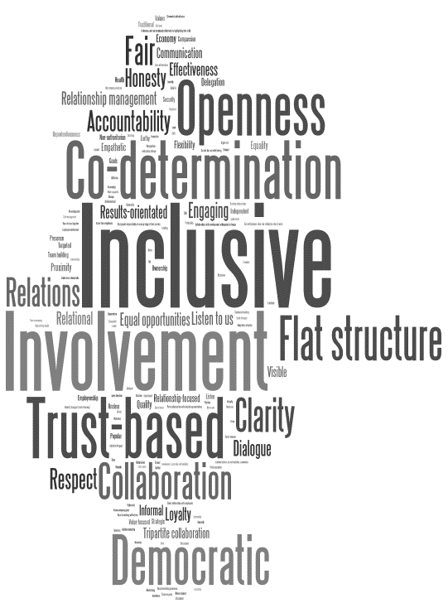
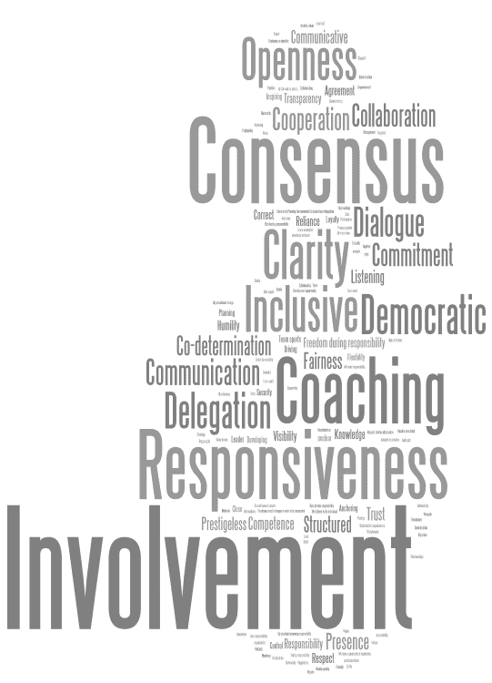
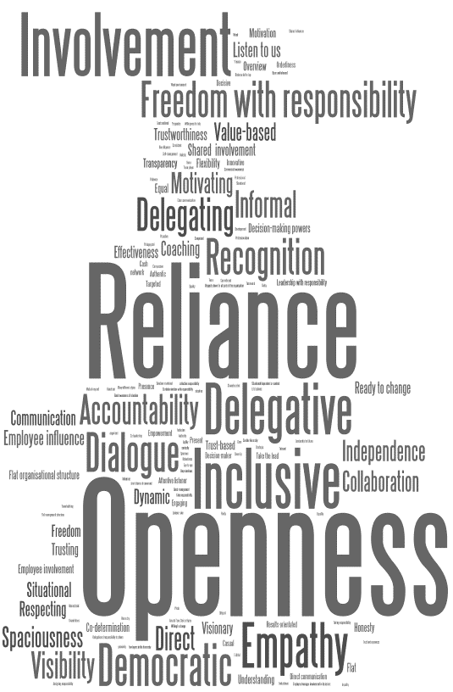
Openness, inclusion and democracy are typical of leadership in all three countries
DK
NO
SV
F1. How leadership is viewed and how it is practised vary between the different countries. Which characteristics/features do you think are typical of Danish/Norwegian/Swedish leadership? Can you give three words that best sum up Danish/Norwegian/Swedish leadership? Base: Denmark 565, Norway 584, Sweden 410

Slide 6
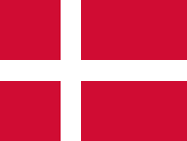
Danish leadership is characterised by communication between leaders and employees. Danish organisations are permissive and non-hierarchical
T2B
86%
81%
79%
76%
75%
73%
65%
65%
61%
61%
60%
60%
58%
48%
41%
35%
23%
19%
F6. We will now show you a series of factors linked to leadership, organisation etc. We would like you to tell us the extent to which each factor is typical of the organisation at which you are currently a manager/leader. Base:565

Slide 7
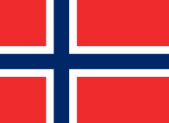
Norwegian leadership is characterised by a short distance between employee and manager, and dialogue is more common than micro management
T2B
82%
76%
75%
73%
73%
72%
71%
70%
60%
59%
59%
58%
57%
48%
39%
31%
28%
22%
F6. We will now show you a series of factors linked to leadership, organisation etc. We would like you to tell us the extent to which each factor is typical of the organisation at which you are currently a manager/leader. Base:584

Slide 8
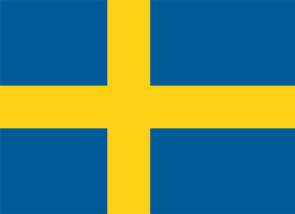
Swedish organisations are characterised more by a high level of communication between leaders and employees and less by hierarchical structures
T2B
84%
80%
80%
79%
78%
77%
74%
70%
68%
66%
64%
57%
51%
43%
40%
33%
28%
23%
F6. We will now show you a series of factors linked to leadership, organisation etc. We would like you to tell us the extent to which each factor is typical of the organisation at which you are currently a manager/leader. Base:410

Slide 9
There are several common denominators shared by the three countries that manifest themselves in Scandinavian leadership. Consensus decision-making is often regarded as being a typical feature of Scandinavian leadership, but is less common in practice
!
The factors underlined here are regarded as typical of Scandinavian leadership and are characteristic of the three countries to varying degrees. (The diagram shows the T2B values, i.e. the total for ‘Quite typical’ and ‘Very typical’.)
F6. We will now show you a series of factors linked to leadership, organisation etc. We would like you to tell us the extent to which each factor is typical of the organisation at which you are currently a manager/leader. Base:565

Slide 10
A larger amount of involvement and influence in and on decision-making processes is of benefit to the employees and is a feature typical of all types of Scandinavian leadership
Danish leadership is characterised by employee influence, as well as a high level of involvement in the decision-making process. Danish employees get to make their voice heard, which is made possible by 'flat' organisations in which there is little distance between leader and employee and by relationships built on trust and openness. Development, freedom with responsibility and independence are key factors, and regarded as being typical of Danish leadership.
“Large degree of freedom of method and the opportunity to influence your own situation at work”
“Large freedom with responsibility, the flat hierarchy of the organisation means that contact with senior management is easy and that day-to-day working is a very dynamic experience.”
“Co-determination/influence Freedom with responsibility”
“Independent employees who take care of tasks themselves and use the manager as their coach, should challenges arise.”
F2. What are the benefits of Danish/Norwegian/Swedish leadership? A) From the employees’ perspective Base: Denmark 565, Norway 584, Sweden 410

Slide 11
A larger amount of involvement and influence in and on decision-making processes is of benefit to the employees and is a feature typical of all types of Scandinavian leadership
Norwegian leadership is typified by a high level of employee involvement in decision-making processes and freedom with responsibility. Creating a good working environment and employee dedication are important. Being seen and heard and being able to influence their own situation at work are important if employees are to feel they have job satisfaction and a sense of togetherness with their colleagues. Empathy, democracy and a short distance between leader and employee are also typical features of Norwegian leadership.
“Freedom with responsibility, inclusion and co-determination”
“Openness. Employees can critique and provided constructive input without this having negative consequences.”
“You are allowed to make mistakes. You include the employees in the development processes Trust and responsibility are interrelated.”
“People are seen and heard to a greater extent, and contribute to matters that are important for their own professional practice. Norwegian leadership provides better conditions for collaboration, loyalty and solidarity. People have a greater degree of influence.”
“High level of co-determination, not so much hierarchy, able to think for yourself and make decisions.”
F2. What are the benefits of Danish/Norwegian/Swedish leadership? A) From the employees’ perspective Base: Denmark 565, Norway 584, Sweden 410

Slide 12
A larger amount of involvement and influence in and on decision-making processes is of benefit to the employees and is a feature typical of all types of Scandinavian leadership
Swedish leadership gives employees a large amount of freedom with responsibility. Feeling seen and heard is important, with communication a key word in Swedish organisations. Development opportunities and getting the chance to be involved in and influence one's own work situation and also the organisation itself are typical of Swedish leadership. Feeling secure is important, as are good conditions that allow employee to balance work and home life.
“Everyone has a chance to have some influence. People feel they are seen and feel appreciated.”
“Able to feel important because they get to be involved in the decision-making process to a certain extent. Responsibilities and powers are clear thanks to the clear structure.”
“More pleasant and personal. Employees get to assume a lot of responsibility and be involved in decisions. A lot of coaching, which improves self-confidence.”
“The openness and perceptiveness makes employees feel seen and are then more motivated.”
F2. What are the benefits of Danish/Norwegian/Swedish leadership? A) From the employees’ perspective Base: Denmark 565, Norway 584, Sweden 410

Slide 13
Two of the benefits of involving employees are greater commitment and better input from employees, which are regarded as a resource in the development of the business
Involving employees and engaging them in the decision-making process also motivates them more and gives them more job satisfaction. The business benefits because they then receive better input and more commitment from employees, which helps to increase efficiency and leads to fewer bottlenecks. When employees assume more responsibility and take more initiative, it delivers better results for the company.
“Employees who are satisfied with their jobs and their training and therefore make a better contribution.”
“Large freedom with responsibility, the flat hierarchy of the organisation means that contact with senior management is easy and that day-to-day working is a very dynamic experience.”
“The high level of trust found in Danish workplaces allows the business to develop at a faster pace and achieve greater productivity, rather than using control-based systems whereby a larger proportion of resources are used on documentation and follow-up instead of value creation.”
“Employees take on large amounts of responsibility compared to in other countries, and are able to take action independently. The flat hierarchy of the organisation makes it easier, and ultimately less costly, to implement restructuring and changes.”
F2. What are the benefits of Danish/Norwegian/Swedish leadership? b) From the company’s perspective Base: Denmark 565, Norway 584, Sweden 410

Slide 14
Two of the benefits of involving employees are greater commitment and better input from employees, which are regarded as a resource in the development of the business
There is clear evidence that Norwegian leadership has several benefits for the company. There is a widespread view that wellbeing and job satisfaction improve efficiency and quality. Employees’ points of view and ideas are considered valuable for the development of the business; the former in turn are stimulated by their high level of involvement in and influence on decision-making processes.
“Everyone moving in the same direction. Little conflict. Focusing on the job in hand. Efficiency”
“Increased effect and production, improvements, good ideas from employees plus good insight into problems etc., which can be communicated to levels where changes can be made; there is a short distance from top to bottom, in the form of opportunities to be heard in the organisation.”
“Employee influence is expertise that can be used to develop the business. The employee’s motivation increases if they are involved in processes and decision-making. Quality assurance benefits for the business.”
“Wellbeing and security improve productivity and make us better ambassadors.”
F2. What are the benefits of Danish/Norwegian/Swedish leadership? b) From the company’s perspective Base: Denmark 565, Norway 584, Sweden 410

Slide 15
Two of the benefits of involving employees are greater commitment and better input from employees, which are regarded as a resource in the development of the business
One of the main benefits of involving and engaging employees is that change work gets firmly established at all levels of the organisation, which simplifies implementation of the work. Another factor important to the success of the business is skills diversity and regarding employees as resources who can drive the business forwards.
“Each employee’s best can be harnessed and used to achieve the collective goal.”
“Employee involvement delivers better results, flat hierarchy creates openness and means high levels of dedication.”
“Decisions already have firm roots, which makes them easier to implement. It is easier to ensure the same approaches (etc.) are used when there is a clear structure.”
“Business is able to overcome complex challenges because everyone, not just the leader, is coming up with clever solutions. Teamwork whereby everyone’s voice gets heard leads to the best solutions.”
“Efficiency; time to do something other than micro management.”
F2. What are the benefits of Danish/Norwegian/Swedish leadership? b) From the company’s perspective Base: Denmark 565, Norway 584, Sweden 410

Slide 16
Employees are expected to take more initiative and expectations of them are high, which doesn't work for everyone. Another drawback is the lack of structure and a clear framework
As highlighted by the survey, the downside of a flat organisation in which employees have a large amount of influence and take responsibility is the lack of structure and a clear framework. This also means that there is more expectation that employees be self-starters and take initiative, which does not work for everyone. Consequently, people who are less forward may become invisible and find it difficult to understand what is expected of them, potentially causing stress. Another drawback is that the decision-making process takes longer because a consensus must be reached across all levels.
“It can be difficult to know whether you are doing well enough and to know what exactly is expected of you.”
“It sometimes takes a long time to get a decision made – it is not always clear who has what responsibility.”
“Some employees simply wish to know what they need to do, when and how.”
“At times, people feel that there is a lack of any leadership giving the business direction, and that the decision-making process is slow.”
F3. What are the drawbacks of Danish/Norwegian/Swedish leadership? A) From the employees’ perspective Base: Denmark 565, Norway 584, Sweden 410

Slide 17
Employees are expected to take more initiative and expectations of them are high, which doesn't work for everyone. Another drawback is the lack of structure and a clear framework
The main drawback of Norwegian leadership is that it takes time to make decisions and implement them. Unclear instructions and ambiguity around work tasks are another disadvantage. The lines between leaders and employees are blurred, and private relationships that make it difficult to understand what the expectations and requirements of employees are may be formed. Despite increasingly open dialogue, employees are expected to take on greater responsibility and get involved and show dedication, which can create uncertainty in a constantly changing working environment that does not have clear goals or monitoring.
“The dividing line between leader and employee may disappear completely in many cases. This can lead to you feeling like you don’t have any leader protecting your own interests.”
“Lots of responsibility, high expectations, not all employees want to be involved – difficult to not be involved (get on with your job without added extras).”
“Potential and motivation are not exploited due to weak leadership; there is a lack of obvious leadership in terms of targets, vision, expectations etc., which creates uncertainty and leads to poor performance.”
“There is a lack of obvious leadership – Norwegian leadership work wells in the good times but not so well in the bad times.”
F3. What are the drawbacks of Danish/Norwegian/Swedish leadership? A) From the employees’ perspective Base: Denmark 565, Norway 584, Sweden 410

Slide 18
Employees are expected to take more initiative and expectations of them are high, which doesn't work for everyone. Another drawback is the lack of structure and a clear framework
The drawbacks associated with Swedish leadership relate in particular to the inertia that might set in when a consensus has to be reached at all levels before a decision is made. The working environment can sometimes be perceived as stressful by the employees who do not want/cannot cope with too much responsibility, with the expectations higher than they used to be. Ambiguity is another drawback of Swedish leadership, i.e. when there is a lack of obvious leadership, when instructions are unclear, and when uncertainty prevails.
“Not everyone needs to be involved in every decision. Swedish managers coach too much and do not do enough leadership.”
“Takes a long time to make decisions, creates uncertainty within the organisation when there is too much time spent on consensus.”
“There can be ambiguity. There can be a heavy workload for people who are dedicated and responsible.”
F3. What are the drawbacks of Danish/Norwegian/Swedish leadership? A) From the employees’ perspective Base: Denmark 565, Norway 584, Sweden 410

Slide 19
The drawbacks of Scandinavian leadership include long decision-making processes, inefficiency and problems with implementation because consensus is required at all levels.
As highlighted by the survey, the drawbacks of Danish leadership relate in particular to inefficiencies, such as long decision-making processes and difficulties implementing strategies, visions and goals when all decisions have to be made collectively. This creates a certain sluggishness in the organisation and places the focus on the process rather than the results. Too much time is spent on discussions and conflicts arising because employees have high expectations of their own influence and sometimes have difficulty accepting decisions they don’t agree with. At an international level, it can be difficult for Danish leadership to gain support because other countries have more hierarchical types of organisation.
“When some kind of democracy is expected in an organisation, employees can feel aggrieved when managers use a more centralised style of leadership to make certain decisions [...].”
“Occasionally, there can be a lack of respect for and implementation of management instructions (active and passive resistance), if the employee does not agree with them, or does not understand the background.”
“Can create problems when there is a mixture of nationalities employed. Some cultures perceive us to be weak leaders if we take advice from employees and ask them for their suggestions.”
F3. What are the drawbacks of Danish/Norwegian/Swedish leadership? b) From the company’s perspective Base: Denmark 565, Norway 584, Sweden 410

Slide 20
The drawbacks of Scandinavian leadership include long decision-making processes, inefficiency and problems with implementation because consensus is required at all levels.
Involving employees heavily in decision-making and processes can have negative consequences for the business. Shifting focus from targets to processes may cause performance to decline and lead to the efficiency of the business decreasing. Processes take a longer time when consensus plays a central role, and restructuring and change become inefficient and unwieldy. Other drawbacks include the fact that Norwegian leadership is perceived as ‘too nice’ in an international context, and that it is a costly type of organisation and requires a large amount of resources.
“There can be too much focus on processes and community and not enough on achieving goals.”
“Too much democracy is inefficient, squanders resources, creates uncertainty and, ultimately, reduces productivity.”
“Flat hierarchies/Norwegian culture perhaps do not work in an international context; we do not think globally, we maybe miss out on certain business opportunities because we are different and do things differently to our competitors.”
“Costly in the short term.”
F3. What are the drawbacks of Danish/Norwegian/Swedish leadership? b) From the company’s perspective Base: Denmark 565, Norway 584, Sweden 410

Slide 21
The drawbacks of Scandinavian leadership include long decision-making processes, inefficiency and problems with implementation because consensus is required at all levels.
The most obvious drawback is the inefficiency that occurs as a result of trying to achieve a consensus across all levels. This makes the organisation sluggish and rigid when faced with changes, when it needs to be flexible. The general view is that leaders avoid making difficult decisions to prevent ‘rocking the boat’.
“In a larger company, it can be more difficult to maintain the level of openness and all-round involvement that is possible in a smaller company in which there is greater proximity between employees. It can be difficult to make decisions quickly in organisations in which everyone is expected to contribute their opinion and expertise.”
“No straightforward decisions, less efficiency in return for employee well-being.”
“Too much consensus creates inertia, makes it impossible to make quick decisions, instils a fear of conflict and means that changes do not happen fast enough.”
“They perhaps drag their heels over the difficult questions sometimes. They avoid being authoritarian even where there is a need for this. They should perhaps remind themselves of this in some cases.”
F3. What are the drawbacks of Danish/Norwegian/Swedish leadership? b) From the company’s perspective Base: Denmark 565, Norway 584, Sweden 410

Slide 22
 | DK | NO | SE
CHARACTERISTICS | Openness, trust, involvement (inclusion), delegation, democracy, freedom with responsibility, empathy, dialogue | Inclusion, trust, co-determination, openness, democracy, flat structure, collaboration, relationships | Involvement, perceptiveness, coaching, consensus, clarity, democracy, openness, inclusion
BENEFITS | The employee is heavily involved in the decision-making process and has influence. Freedom with responsibility and independence are also typical of Danish leadership. Greater commitment from employees helps to increase efficiency and improve input. | Norwegian leadership gives employees a high level of involvement in decision-making processes. There is also a focus on collaboration, wellbeing and job satisfaction at work, which improves the work being carried out as well as productivity. Employees’ ideas are important and are stimulated through involvement. | Freedom with responsibility is a typical characteristic of Swedish leadership. Development opportunities and being able to influence your own work situation are made possible by the largely coaching-type leadership found in the country. Increasing the diversity of the skills base is important for the success of the business, and employees are considered to be resources.
DRAWBACKS | The downside of a flatter hierarchy in which employees have more responsibility is the lack of any clear framework or structure. It also means there is more expectation that employees will take initiative, which can be stressful for individuals who need clear guidance. Decision-making can take longer because there has to be consensus at all levels. Another drawback are the difficulties faced when trying to get this type of leadership to work on the international market, where hierarchical organisational structures are common. | One downside of Norwegian leadership is that it takes time to make decisions and implement them. Unclear goals also make it difficult for employees to understand what is expected from them. The high level of responsibility expected of employees does not work for everyone either. The focus is shifted from targets to processes and, as organisational structures go, it is somewhat costly and unwieldy. On an international level, Norwegian leadership is perceived as being ‘too nice’. | The decision-making process suffers from inertia because decisions have to have firm roots at every level. Another drawback is the lack of any obvious leadership, which creates uncertainty and means the structure is unclear. Certain employees do not want to/cannot take on more responsibility, and the working environment can be perceived as stressful. There is a perception that leaders avoid making difficult decisions and avoid ‘rocking the boat’. The inertia that sets in when trying to reach a consensus limits the amount of flexibility the business has to go through changes.

Slide 23
Coaching and inclusive leadership are most important if leadership is to be optimal. Denmark typically attaches slightly more importance than the other countries to delegation during leadership and less on participation
F4. Delegating, advising, instructing, participating and coaching are some of the common types of leadership. We would like to know how you think these styles of leadership should be combined to create ‘optimal leadership’. Distribute the 100% between the fives styles of leadership according to how much of each you think should be incorporated into ‘optimal leadership’. Base: Denmark 565, Norway 584, Sweden 410 *The percentages are based on the mean and add up to 100% for each country

Slide 24
Clarity is the most important characteristic for successful leadership in all countries. In Sweden, coaching is important if you are a leader, whereas being honest is more important in Norway and Denmark
F5. You are now going to be shown a number of different characteristics. We would like to know how important you think these are for successful leadership. On each screen, we want you to choose the least important and the most important characteristic. *MaxDiff – An index out of 100 is used to score each attribute. An index score of 50 means that the attribute is half as important as the most important attribute. Base: Denmark 565, Norway 584, Sweden 410

Slide 25
Three different types of leadership have been identified based on the attributes respondents think are most important if leadership is to be successful. Each style of leadership is typical for each of the Scandinavian countries
LEDARNA | IPSOS PUBLIC AFFAIRS
DEMOCRATIC LEADERSHIP
TARGETED LEADERSHIP
RELATIONSHIP-ORIENTATED LEADERSHIP

Slide 26
LEDARNA | IPSOS PUBLIC AFFAIRS
DEMOCRATIC LEADERSHIP
TARGETED LEADERSHIP
RELATIONSHIP-ORIENTATED LEADERSHIP
Democratic leadership is based around the idea that fairness, honesty and perceptiveness are key if leadership is to be successful. It attaches less importance to results and relationship-orientated attributes such as being a coach and being communicative.
Targeted leadership attaches importance to being rational, intelligent, innovative and results-orientated. Relationship-orientated-type attributes, such as being a coach, fair, empathetic, perceptive and honest, are considered less important.
Relationship-orientated leadership puts a premium on leaders being coaches, communicative and perceptive. Less importance is attached to fairness, honesty and results.
Found more commonly in/among:
Norway
Heads of section, first-line managers, team leaders, foremen
Males
Private sector
Found more commonly in/among:
Denmark
Chief executives/company directors
Males
Private sector
Found more commonly in/among:
Sweden
Heads of section, first-line managers, team leaders, foremen
Females
Public sector

Slide 27
APPENDIX

Slide 28
There is a pattern across the Scandinavian countries when it comes to how leaders/managers divide their time between different work tasks
F7. Below you will find a number of different areas of work/tasks that form part of your role as a boss/manager. We would like to know how much time you spend on each area/task. Divide the 100% up between the areas/tasks below. Base: Denmark 565, Norway 584, Sweden 410 *The percentages are based on the mean and add up to 100% for each country

Slide 29

RESPONDENT PROFILE
RECRUITMENT PROCESS
FIRST LEADERSHIP POSITION
The majority of managers/leaders did not do any tests in connection with the appointment
DK
DK
DK
NO
SV
NO
NO
SE
SE
Of those who did tests, the tests were usually personality tests, but there were also other tests involved.
One to two interviews is most common as part of the recruitment process in the Scandinavian countries
DK
NO
SV
DK
NO
SV
2
1
2
Base:
B1. What position do you have in the organisation? Base: Denmark 565. Norway 584, Sweden 410 I B11. How many interviews were there in the recruitment process you underwent before joining your current employer? Denmark 565, Norway 584, Sweden 410 I B12. Did you do any tests as part of the recruitment process? Denmark 565, Norway 584, Sweden 410, B13. What type of test was it? Denmark 262, Norway 150, Sweden 186, B.14 How did you get your first managerial role? Denmark 565, Norway 584, Sweden 410

